Slide 1
BIA Core SPR Results
Spyros Pavlidis
RNA Aptamers
BSA
Histone, Calf Thymus
Brian Watts, Ph.D.
BIA Core Facility
October 5-8, 2020

Slide 2
Experimental Details
(SPR – Biacore T200)
Instrument Preparation
Completed Desorb and Sanitize cleaning procedure x 1 and Desorb procedure using RNase Away x 3.
System run on standby with Milli-Q Water as running buffer for several days to rinse system.
RNA Aptamer Immobilization
Immobilized thiolated RNA aptamer via incubation on a blank Au sensor chip.
RNA Immobilization: 1 µM RNA aptamer; 18,000 sec x 3 @ 1 µL/min on Fc4 (15 hr incubation)
Spacer Immobilization: 1 mM 6-Mercapto-1-hexanol (MCH); 18,000 sec @ 1 µL/min on Fc3,4 (5 hr incubation)
Analyte Preparation
Weighed out ~10 mg of dry Calf Thymus Histone (CTH) and Bovine Serum Albumin (BSA) and solubilized in 2 mL HBS-EP+.
Measured concentration via nanodrop for BSA (MW = 66,500 g/mol, ε = 43,824 M⁻¹cm⁻¹) and CTH (MW = 14,956 g/mol, ε = 5,376.5 M⁻¹cm⁻¹) stocks.
Binding Screen
Manually identified ideal regeneration condition via sequential injection.
Set up method to screen BSA and CTH against MCH and RNA/MCH surfaces.
Flow Cells: 3,4 (Ref sub. 4-3)
Binding: 180 sec association, 600 sec dissociation @ 30 µL/min
Regeneration: 50 mM NaOH, 1 M NaCl, 60 sec @ 30 µL/min (30 sec baseline stabilization)
Exp 1: 0, 1.56, 3.13, 6.25, 12.5, 25, 50, 100, 200 nM BSA
0, 1.35, 2.71, 5.41, 10.8, 21.7, 43.3, 86.3, 173.2 nM CTH*
Exp 2: 0, 0.10, 0.20, 0.39, 0.78, 1.56, 3.13, 6.25, 12.5, 25, 50, 100 nM BSA
0, 0.10, 0.20, 0.39, 0.78, 1.56, 3.13, 6.25, 12.5, 25, 50, 100 nM CTH
*CTH dilutions for Exp 1 were originally made to match BSA dilutions, however recalculation of the MW and ε of CTH reduced the calculated stock concentration and subsequent dilutions.
BEW

Slide 3
BSA Binding Results (Exp 1)
MCH Surface (Fc3, Raw)
Buffer Subtracted
18
RNA Surface (Fc4-3, Ref. Sub.)
MCH Surface Subtracted, Buffer Subtracted
13
200 nM BSA
1.5
100 nM BSA
Response (RU)
50 nM BSA
1
8
25 nM BSA
0.5
12.5 nM BSA
6.25 nM BSA
0
200 nM BSA
3
3.125 nM BSA
-0.5
100 nM BSA
1.5625 nM BSA
Response (RU)
50 nM BSA
0 nM BSA
-1
25 nM BSA
-2
-1.5
12.5 nM BSA
-100
0
100
200
300
400
500
600
700
800
-2
6.25 nM BSA
Time (s)
3.125 nM BSA
-2.5
1.5625 nM BSA
RNA Surface (Fc4. Raw)
Buffer Subtracted
-3
0 nM BSA
18
-3.5
-100
0
100
200
300
400
500
600
700
800
16
Time (s)
14
12
200 nM BSA
Purpose
Determine if specific binding of BSA to MCH and RNA surfaces is observed.
Results
No BSA binding detected to either MCH or RNA surfaces
10
100 nM BSA
50 nM BSA
Response (RU)
25 nM BSA
8
6
12.5 nM BSA
6.25 nM BSA
4
3.125 nM BSA
2
1.5625 nM BSA
0
0 nM BSA
-2
-100
0
100
200
300
400
500
600
700
800
Time (s)

Slide 4
CTH Binding Results (Exp 1)
MCH Surface (Fc3, Raw)
Buffer Subtracted
180
RNA Surface (Fc4-3, Ref. Sub.)
MCH Surface Subtracted, Buffer Subtracted
130
173.2 nM CTH
300
86.6 nM CTH
Response (RU)
43.3 nM CTH
80
21.65 nM CTH
250
10.825 nM CTH
200
5.4124 nM CTH
173.2 nM CTH
30
2.7062 nM CTH
86.6 nM CTH
1.3531 nM CTH
150
43.3 nM CTH
0 nM CTH
Response (RU)
21.65 nM CTH
-20
100
10.825 nM CTH
-100
0
100
200
300
400
500
600
700
800
5.4124 nM CTH
Time (s)
50
2.7062 nM CTH
1.3531 nM CTH
RNA Surface (Fc4, Raw)
Buffer Subtracted
0
0 nM CTH
450
-50
-100
0
100
200
300
400
500
600
700
800
Time (s)
s
Purpose
Determine if specific binding of CTH to MCH and RNA surfaces is observed.
Results
Observed CTH binding to both MCH and RNA surfaces.
CTH binding to MCH surface weaker than binding to RNA surface.
Suggests detection of specific binding of CTH to the RNA surface
Binding curve morphology degraded at higher concentrations likely due to saturation of the surface binding sites resulting in aggregation and/or aberrant signal changes.
350
173.2 nM CTH
86.6 nM CTH
250
43.3 nM CTH
Response (RU)
21.65 nM CTH
150
10.825 nM CTH
5.4124 nM CTH
2.7062 nM CTH
50
1.3531 nM CTH
0 nM CTH
-50
-100
0
100
200
300
400
500
600
700
800
Time (s)

Slide 5
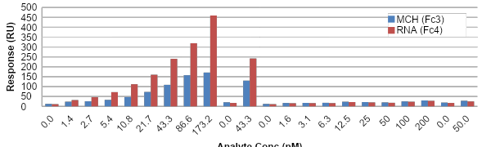
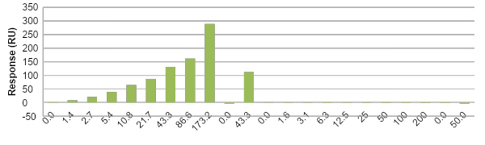
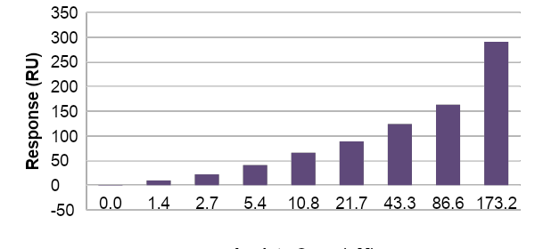
Binding Results Summary (Exp 1)
MCH and RNA Binding Response (Raw)
 |  | MCH (Fc3) | RNA (Fc4) | RNA - MCH (Fc4-3) | [RNA - MCH] - BSA
Analyte | Conc (nM) | Resp (RU) | Resp (RU) | Resp (RU) | Resp (RU)
CTH | 0 | 12.5 | 11 | -1.4 | -0.85
CTH | 1.35 | 23.5 | 31.7 | 8.2 | 9.7
CTH | 2.71 | 25.6 | 46.2 | 20.6 | 22
CTH | 5.41 | 32.7 | 71.8 | 39.1 | 40.8
CTH | 10.8 | 47.3 | 111.9 | 64.6 | 66.1
CTH | 21.7 | 72.8 | 159.8 | 87 | 88.8
CTH | 43.3 | 108.8 | 240.1 | 131.3 | 124.25
CTH | 86.6 | 157.4 | 319.2 | 161.8 | 163.5
CTH | 173.2 | 170.9 | 459.7 | 288.8 | 290.8
CTH | 0 | 20.5 | 17.2 | -3.3 | -1.6
CTH | 43.3 | 130 | 242 | 112.1 | 115.4
BSA | 0 | 12.3 | 11 | -1.3 | --
BSA | 1.56 | 17.1 | 15.7 | -1.5 | --
BSA | 3.13 | 17.6 | 16.2 | -1.4 | --
BSA | 6.25 | 17.9 | 16.2 | -1.7 | --
BSA | 12.5 | 23.3 | 21.7 | -1.5 | --
BSA | 25 | 21.6 | 19.9 | -1.8 | --
BSA | 50 | 19.9 | 18 | -1.8 | --
BSA | 100 | 25.1 | 23.4 | -1.7 | --
BSA | 200 | 29.8 | 27.8 | -2 | --
BSA | 0 | 19 | 17.2 | -1.7 | --
BSA | 50 | 28.2 | 24.9 | -3.3 | --
CTH
BSA
RNA Binding Response (MCH Cont. Surf. Subtracted)
CTH
BSA
RNA Binding Response
(MCH Cont. Surf., BSA Cont. Subtracted)
Results
1.35 nM is lowest concentration that produced detectable binding signal

Slide 6
Binding Kinetics Results (Exp 1)
Results
Appropriate kinetics/affinity calculations require purified, homogeneous solutions of biomolecules with accurately determined concentrations.
Due to the CTH analyte being a mixture of 5 different histone proteins, obtaining a true measure of the kinetics and affinity of the CTH-RNA interaction is not possible.
The binding curves obtained in this assay are a result of the complex combination of association, dissociation, and competition interactions of the 5 histone proteins with the RNA surface.
While a dose-dependent CTH binding response is observed, the obtained binding curves are poorly fit by the 1:1 binding model (Chi² = 9.73 RU²). The poor fit is not surprising considering the heterogeneity of the analyte.
The apparent affinity for the bulk interaction between CTH and the RNA surface can be calculated (assuming the concentration used for CTH was determined appropriately).
RNA Surface (Fc4-3, Ref. Sub.)
MCH Surface Subtracted, Buffer Subtracted
160
140
43.3 nM CTH
21.65 nM CTH
120
10.825 nM CTH
5.4124 nM CTH
100
2.7062 nM CTH
1.3531 nM CTH
80
Response (RU)
60
40
20
0
-20
-100
0
100
200
300
400
500
600
700
800
Time (s)
1:1 Binding Model
k_{a} (1/Ms) | k_{d} (1/s) | K_{d} (M) | K_{d} (nM) | Chi² (RU²)
2.59E+06 | 1.06E-03 | 4.08E-10 | 0.4 | 9.73

Slide 7
Binding Results Summary (Exp 2)
BSA
RNA Surface (Fc4-3, Ref. Sub.)
MCH Surface Subtracted, Buffer Subtracted
3
Purpose
Determine lower limit of detection of CTH binding to an RNA surface.
Results
No BSA binding detected to either MCH or RNA surfaces
CTH binding again observed to both MCH and RNA surfaces
RNA surface appears to have degraded demonstrated by the overall lower CTH-RNA binding responses, higher CTH-MCH binding responses, and poor curve morphology.
Unable to define an LOD lower than the previously measured 1.35 nM CTH.
2
100 nM CTH
1
50 nM CTH
25 nM CTH
0
12.5 nM CTH
Response (RU)
6.25 nM CTH
-1
3.13 nM CTH
1.56 nM CTH
-2
0.78 nM CTH
-3
0.39 nM CTH
0.20 nM CTH
-4
0.10 nM CTH
0 nM CTH
-5
-100
0
100
200
300
400
500
600
700
800
Time (s)
RNA Surface (Fc4-3, Ref. Sub.)
MCH Surface Subtracted, Buffer Subtracted
CTH
200
150
100 nM CTH
50 nM CTH
25 nM CTH
12.5 nM CTH
100
6.25 nM CTH
Response (RU)
3.13 nM CTH
1.56 nM CTH
50
0.78 nM CTH
0.39 nM CTH
0.20 nM CTH
0
0.10 nM CTH
0 nM CTH
-50
-100
0
100
200
300
400
500
600
700
800
Time (s)

Slide 8
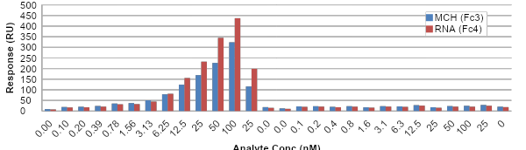
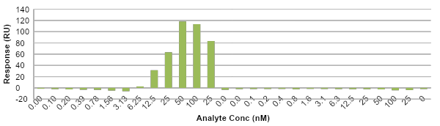
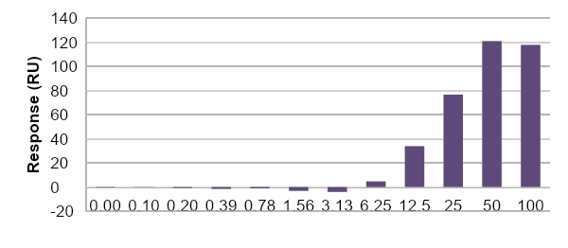
Binding Results Summary (Exp 2)
MCH and RNA Binding Response (Raw)
 |  | MCH (Fc3) | RNA (Fc4) | RNA - MCH (Fc4-3) | [RNA - MCH] - BSA
Conc (nM) | Analyte | Resp (RU) | Resp (RU) | Resp (RU) | Resp (RU)
CTH | 0 | 8.9 | 7.4 | -1.5 | -0.4
CTH | 0.10 | 18.9 | 16.7 | -2.2 | -0.2
CTH | 0.20 | 20.1 | 17.5 | -2.7 | -0.8
CTH | 0.39 | 23.8 | 20.6 | -3.3 | -1.5
CTH | 0.78 | 35.3 | 31.7 | -3.5 | -1.1
CTH | 1.56 | 37.4 | 32.6 | -4.8 | -3.1
CTH | 3.13 | 50.4 | 44.5 | -5.9 | -4
CTH | 6.25 | 78.7 | 81.2 | 2.5 | 4.6
CTH | 12.5 | 124.1 | 155.5 | 31.4 | 33.7
CTH | 25 | 169 | 232.5 | 63.4 | 76.45
CTH | 50 | 226.6 | 344.7 | 118.1 | 120.8
CTH | 100 | 323.8 | 437.2 | 113.4 | 117.7
CTH | 25 | 115.7 | 199 | 83.3 | 87.2
CTH | 0 | 18.3 | 14.9 | -3.4 | -1.4
BSA | 0 | 12.4 | 10.3 | -2.1 | --
BSA | 0.10 | 21.7 | 19.7 | -2 | --
BSA | 0.20 | 22.6 | 20.8 | -1.9 | --
BSA | 0.39 | 19.8 | 17.9 | -1.8 | --
BSA | 0.78 | 22.8 | 20.4 | -2.4 | --
BSA | 1.56 | 17.5 | 15.8 | -1.7 | --
BSA | 3.13 | 22.9 | 20.9 | -1.9 | --
BSA | 6.25 | 21.7 | 19.6 | -2.1 | --
BSA | 12.5 | 27.6 | 25.3 | -2.3 | --
BSA | 25 | 17.6 | 15.3 | -2.3 | --
BSA | 50 | 23.3 | 20.6 | -2.7 | --
BSA | 100 | 24.6 | 20.4 | -4.3 | --
BSA | 25 | 28.6 | 24.7 | -3.9 | --
BSA | 0 | 20.4 | 18.4 | -2 | --
CTH
BSA
RNA Binding Response (MCH Cont. Surf. Subtracted)
CTH
BSA
RNA Binding Response
(MCH Cont. Surf., BSA Cont. Subtracted)

